Slide 1
Housing Prices in King County
Kelsey Siman

Slide 2
The Methodology
Obtain – find the right dataset
Scrub – make data ready for analytics
Explore – get to know what the data looks like
Model – find out what elements of the dataset have greatest impact on price
Interpret – what does this data show us?

Slide 3
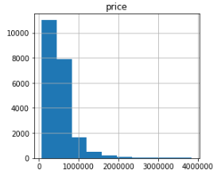
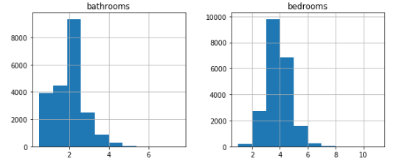
The data – King county dataset
Includes homes sold between May 2014 and May 2015
Comprehensive – includes sell date, price, number of bedrooms, number of bathrooms, square footage, year built, zip code…
SAMPLE KING COUNTY DATA HISTOGRAMS
# of homes
price ($) # of bathrooms # of bedrooms

Slide 4
The Questions
What is the most important predictor for housing prices in King County?
Which characteristics should you look for in a King County home?
Which should you avoid?

Slide 5
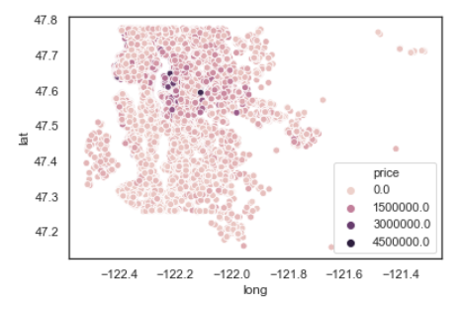
The Answers: Location, Location, Location
Location (particularly zip code) is the most relevant predictor of price
Zip codes to look for:
98039 (Medina)
98004 (Bellevue)
Zip codes to avoid:
98002, 98001 (Auburn)
98168, 98148 (Seattle)
98040 (Mercer Island)
98112, 98109 (Seattle)
price
$0.0m
$1.5m
$3.0m
$4.5m
98032 (Kent)

